Slide 1

One Health Workshop Qualitative group
Manila, July 8th 2026

Slide 2
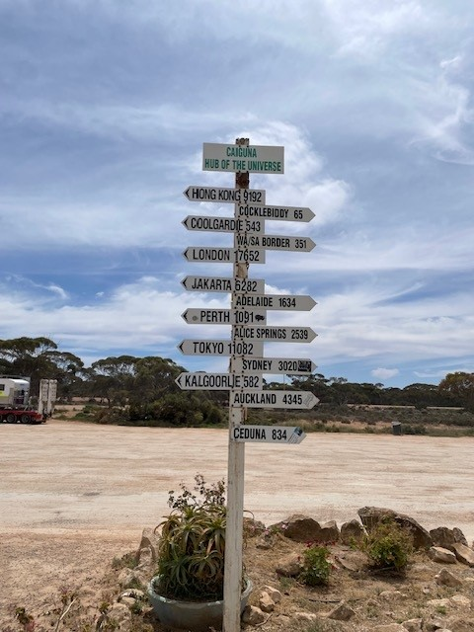
What are we aiming to do?
Identify
Needs and appropriate actions for each function of the Multi-Sectoral One Health Council

Slide 3
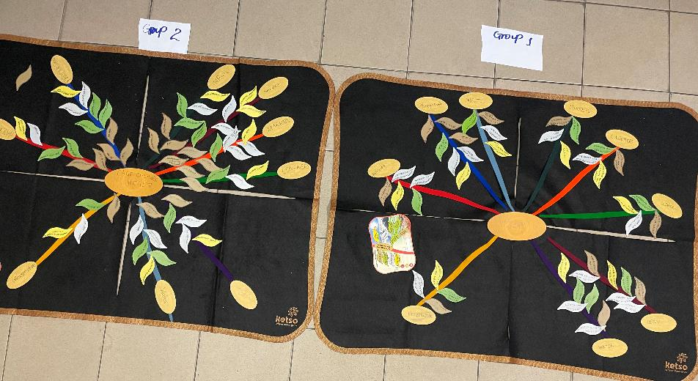

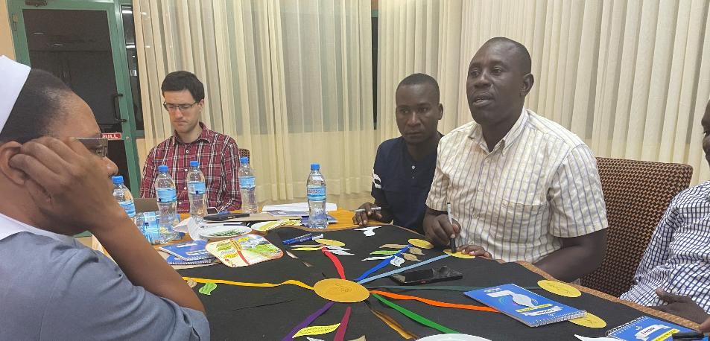
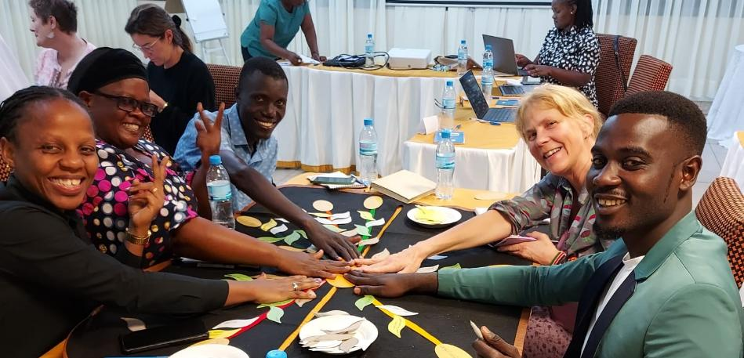
How will we do it?
Notes:
Explain that this was a method I used while investigating farming practices among fish farmers (including whether they vaccinate their fish!!). It was a really useful way to to bring stakeholders together to identify issues, potential solutions and then prioritise what to do first. The colleague who introduced me to it had previously used it to bring together Massai warriors to talk about brucellosis prevention

Slide 4
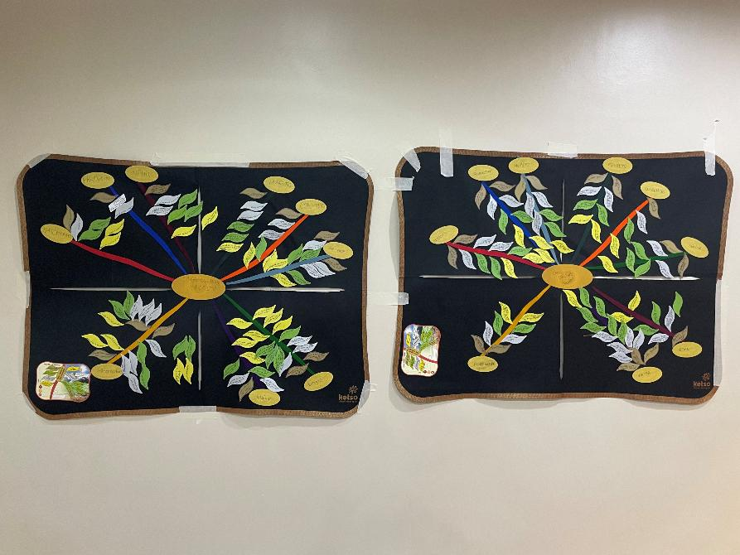
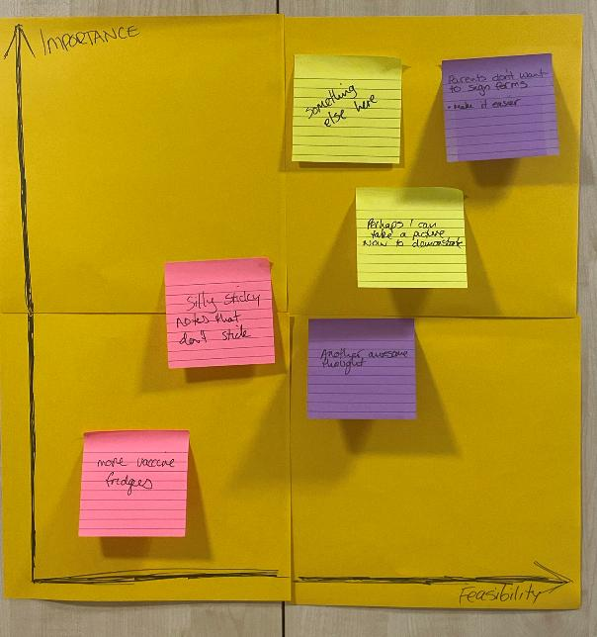
Preview of today’s outputs
Identify actions to be taken
2) Prioritise which should be done first
Notes:
I’ll go into more detail in as we move through the process, but this is what the outputs will look like at the end of the day, just so you can see where we’re heading (explain each ketso board and what they represent)

Slide 5
Preview of today’s outputs
Notes:
I’ll go into more detail in as we move through the process, but this is what the outputs will look like at the end of the day, just so you can see where we’re heading (explain each ketso board and what they represent)

Slide 6

Step 1: Discuss the functions of the MSOHC
Each table has a Province in the centre circle:
Oriental Mindoro
Romblon
Marinduque
Around each Centre circle are the seven functions of the MSOHC (see section 5 of Ordinance document)
Develop plans and oversee implementation
Facilitate collaboration
Surveillance (early warning / reporting system)
Outbreak investigation and response
Monitoring and evaluation
Preventative measures
Preparedness and capacity building
Notes:
This step is for the 11am breakout group

Slide 7
Step 1: Agree on the key issues (40 mins)
Add example issue
Add example issue

Slide 8
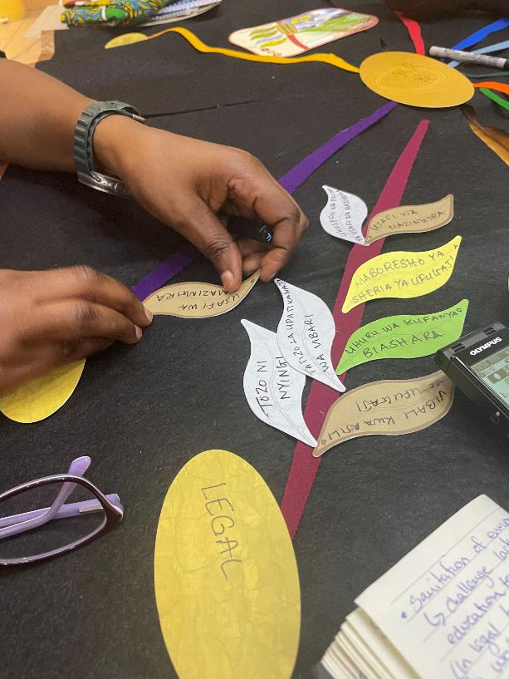
Step 2: Identify actions to take and how to take them
For each issue (“spoke”):
Discuss:
What do you already know?
Who do you need in the room?
What do you need to know? Ask facilitators!
Write down on the leaves:
What actions do we need to take? (green leaves)
Who will do them? (yellow leaves)
How will they be done? (brown leaves)
Notes:
This step is for the 1:30 session

Slide 9
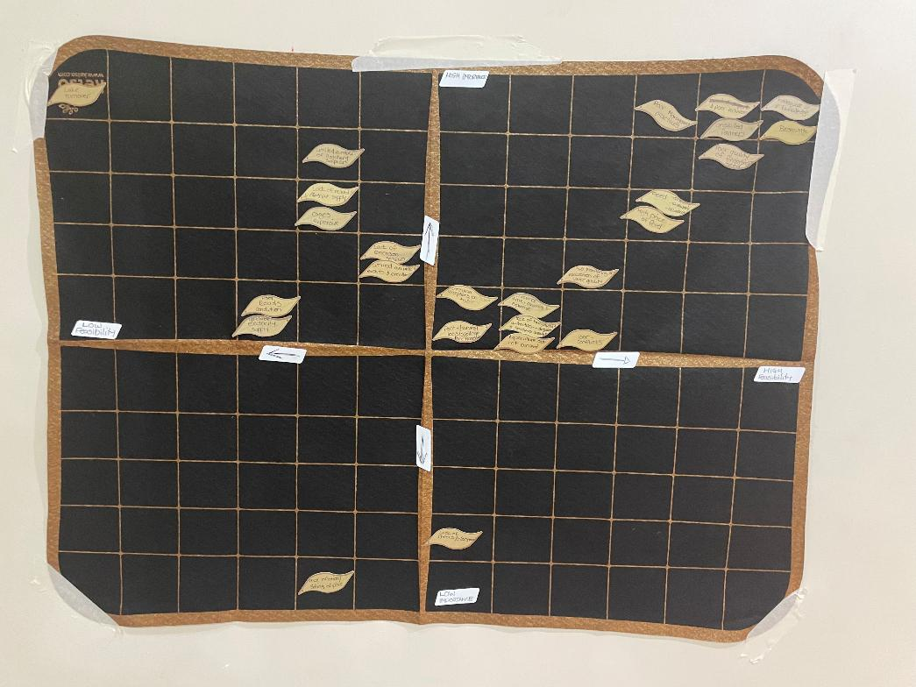
Step 3: prioritisation (30 mins)
As a group, order the solutions from lowest to highest importance along the Y-axis
Now, move the ordered solutions from lowest to highest feasibility along the X-axis
Note: Feasibility is a broad-brush estimate of cost and time, try not to get too “lost in the weeds”
HIGH IMPORTANCE
LOW FEASIBILITY
HIGH FEASIBILITY
LOW IMPORTANCE

Slide 10


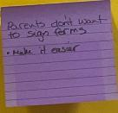

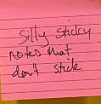

Step 3: prioritisation
HIGH IMPORTANCE
As a group, order the post-its with action statements from lowest to highest importance along the Y-axis
LOW IMPORTANCE

Slide 11
Step 3: prioritisation
HIGH IMPORTANCE
As a group, order the post-its with action statements from lowest to highest importance along the Y-axis
Now, move the ordered solutions from lowest to highest feasibility along the X-axis
Note: Feasibility is a broad-brush estimate of cost and time, try not to get too “lost in the weeds”
LOW FEASIBILITY
HIGH FEASIBILITY
LOW IMPORTANCE

